Slide 2
MEMENTO MORI

Slide 3
“For we know that if our earthly dwelling, a tent, should be destroyed, we have a house from God, a dwelling not made with hands, everlasting in heaven.” 2Cor 5,1

Slide 4
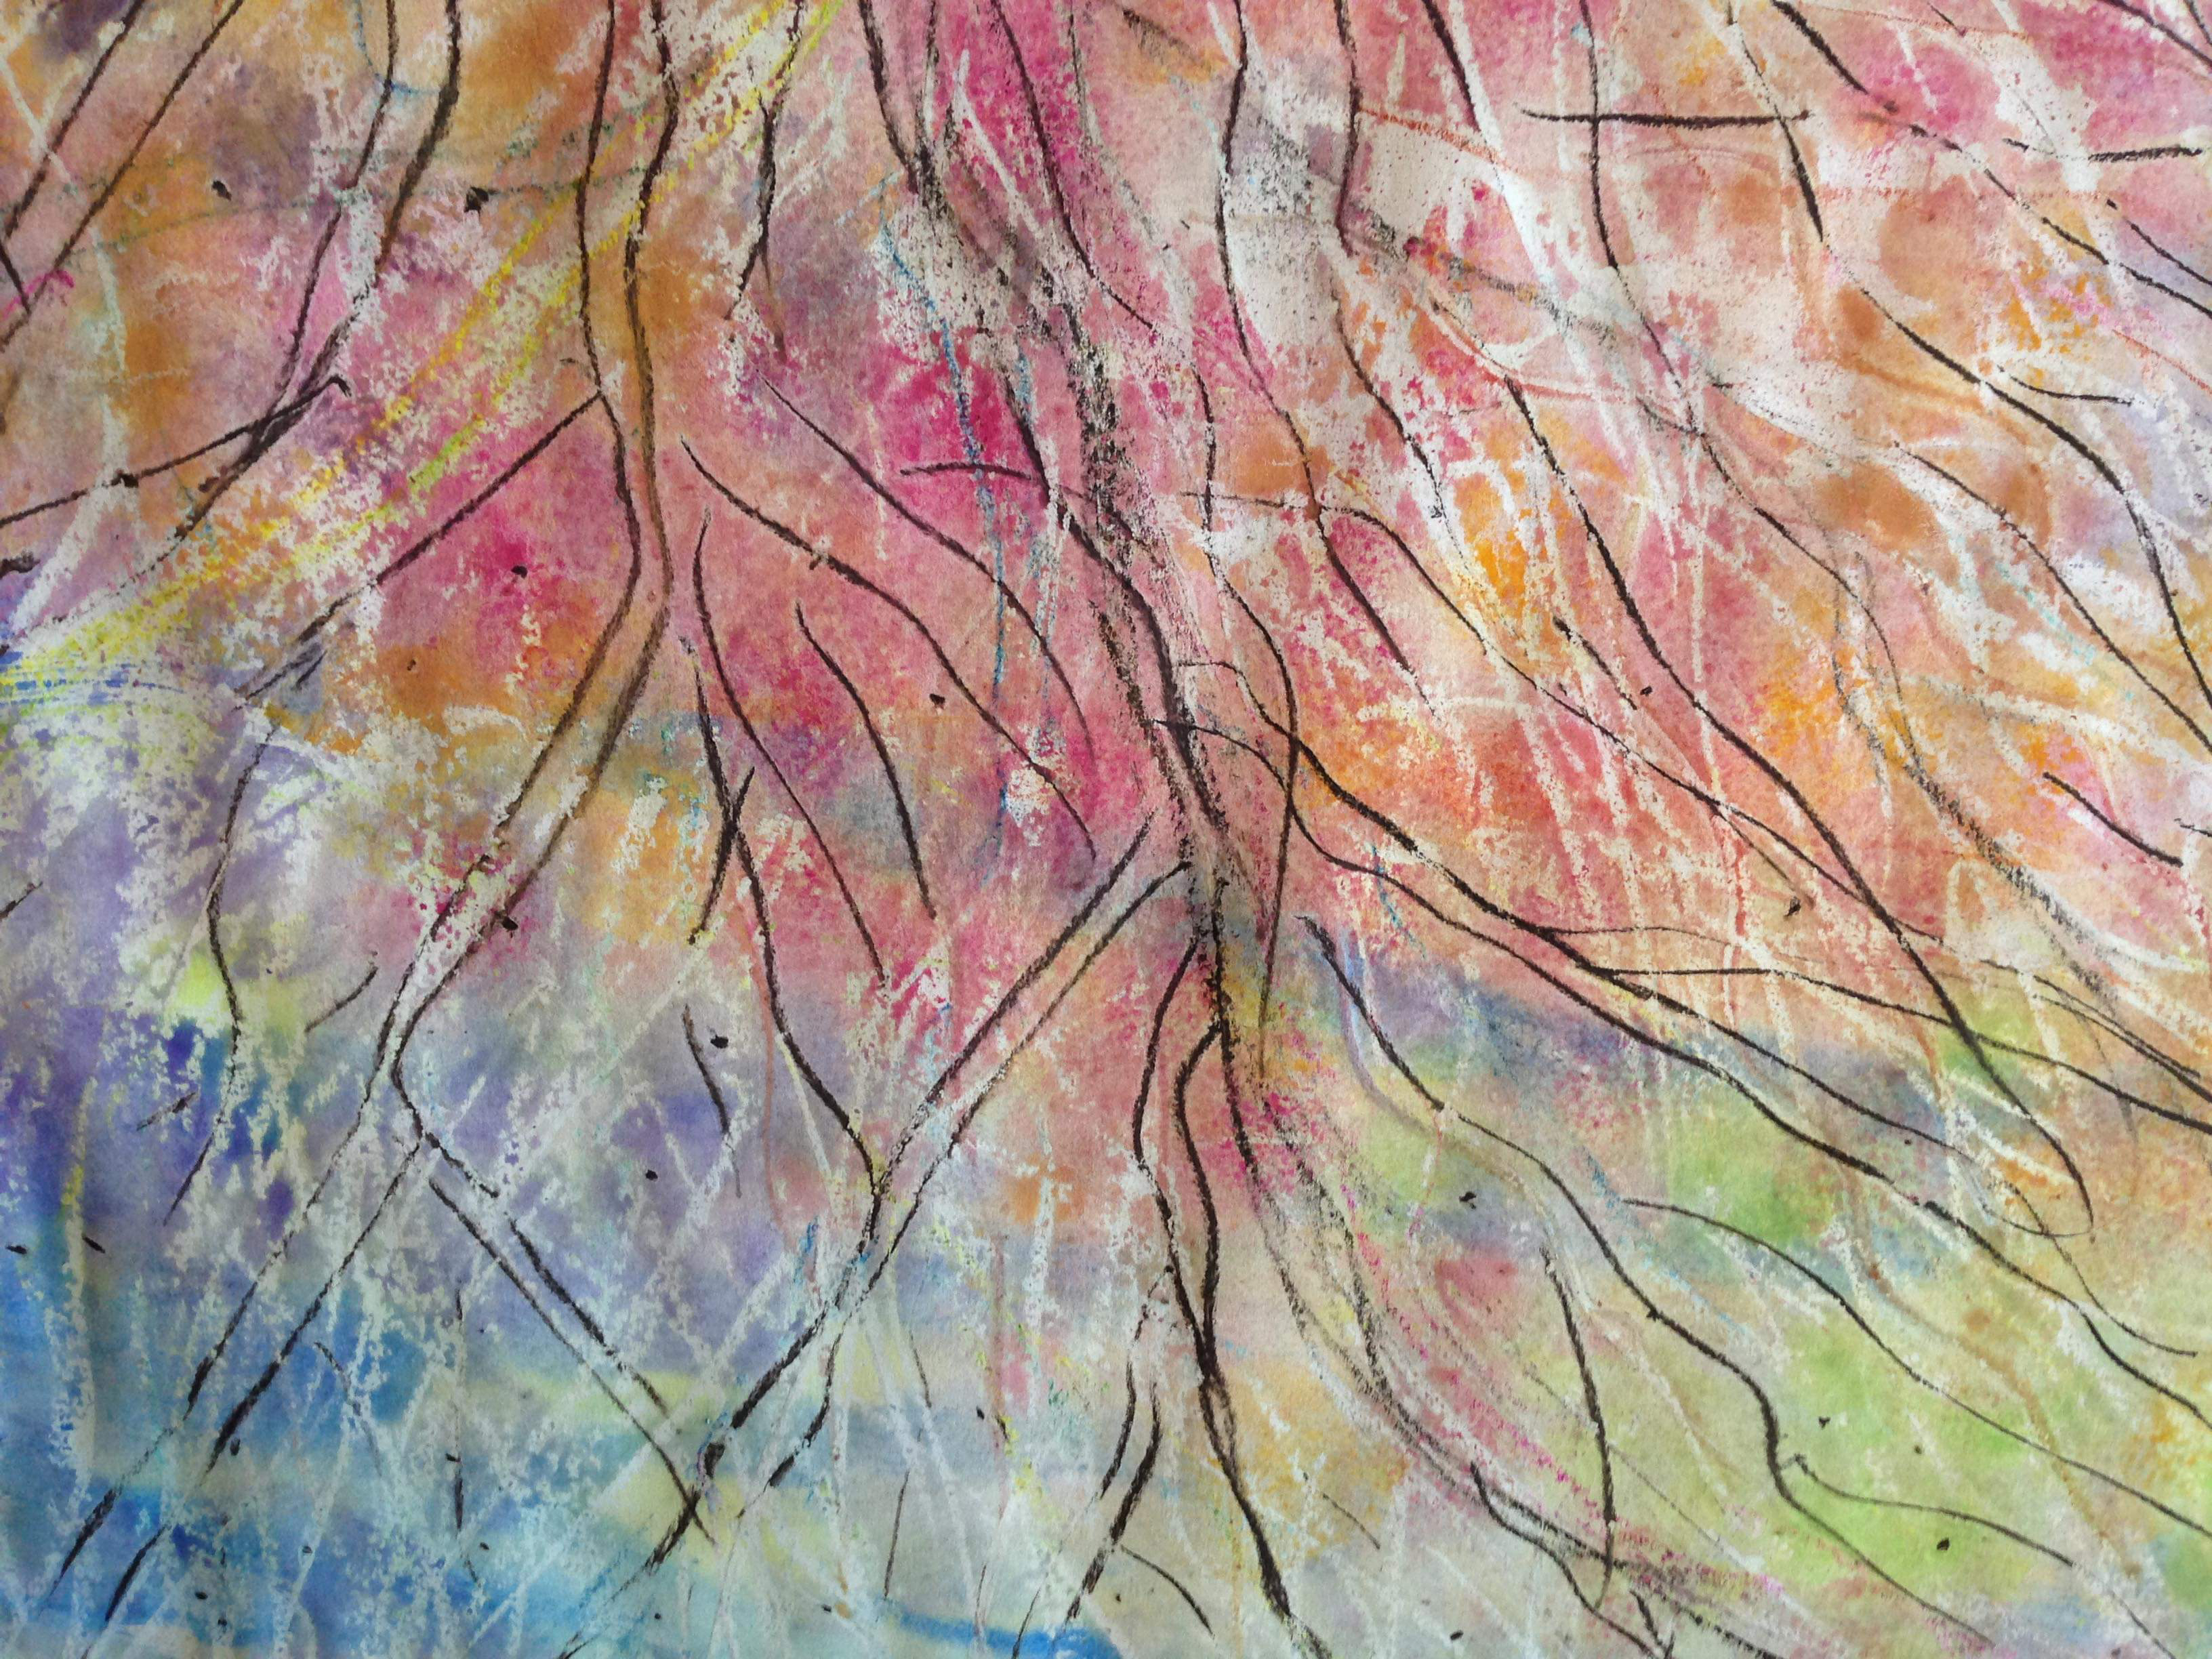
We hold a treasure
Not made of gold
In earthen vessels, wealth untold
One treasure only, the Lord,
the Christ
In earthen vessels.

Slide 5
Light has shown in our darkness.
God has shown in our hearts
With the light of the glory
Of Jesus the Lord.

Slide 6
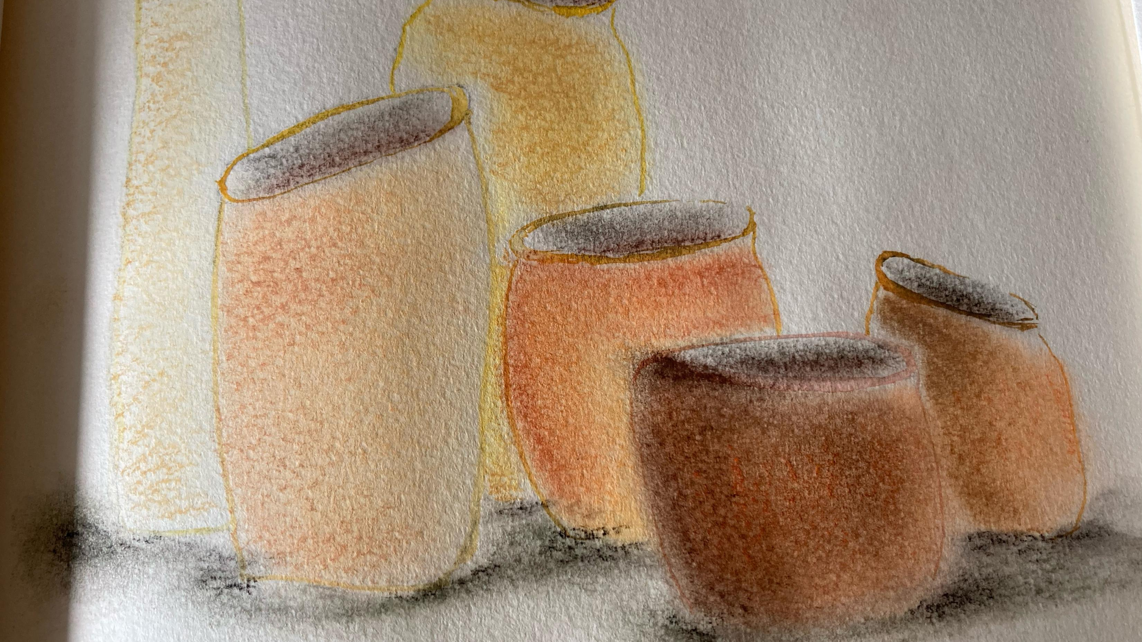
We hold a treasure
Not made of gold
In earthen vessels, wealth untold
One treasure only, the Lord,
the Christ
In earthen vessels.

Slide 7
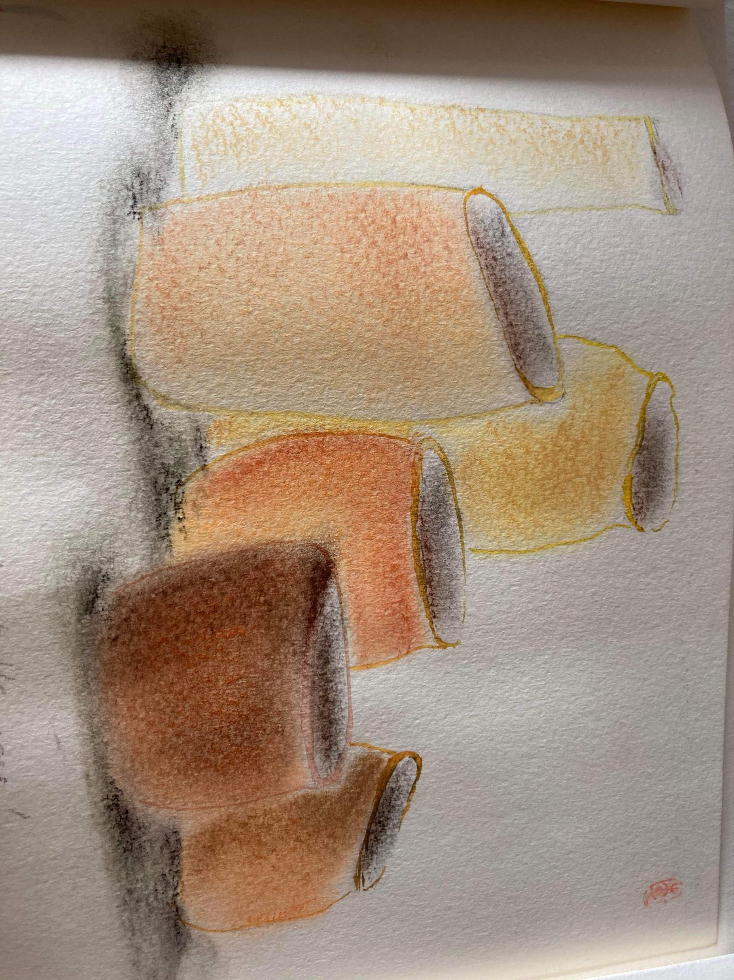
He has chosen the lowly
Who are small in this world
In his weakness His Glory
In Jesus the Lord.

Slide 8
We hold a treasure
Not made of gold
In earthen vessels, wealth untold
One treasure only, the Lord,
the Christ
In earthen vessels.

Slide 9
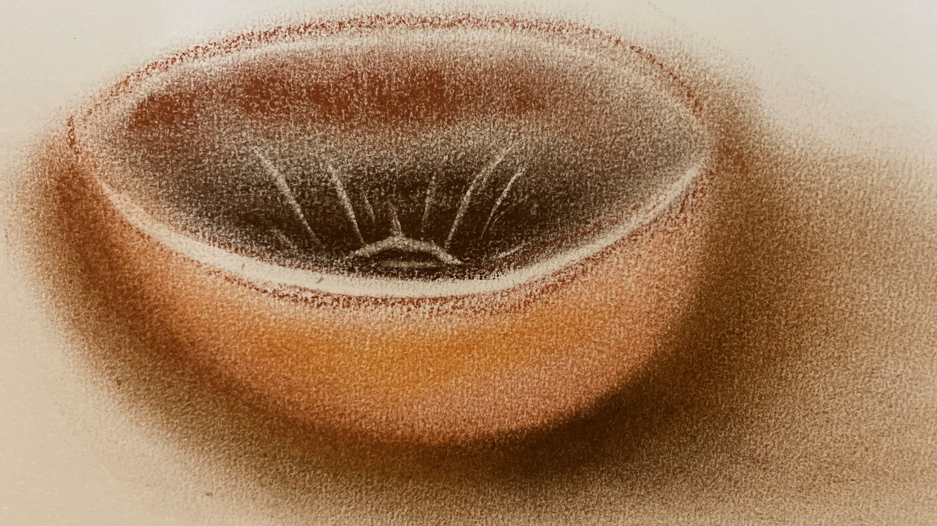
One treasure only, the Lord, the Christ

Slide 10
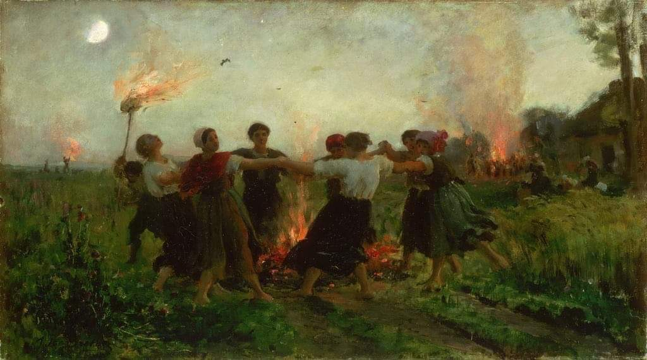
Lord, Jesus, we place our work and ourselves into your hands. May our creativity, our ideas, our energy bring life for the Society and the world. Bless our capitulants with wisdom and discernment. Rooted in your love may our all activities be done in and through your name. Amen.

